Slide 1
Introduction to Graphics with Stata
Alicia Doyle Lynch
Harvard MIT Data Center

Slide 2
Documents for Today
Find class materials at: http://libraries.mit.edu/guides/subjects/data/training/workshops.html
Several datasets
Presentation slides
Handouts
Exercises
Let’s go over how to save these files together

Slide 3
Organization
Please feel free to ask questions at any point if they are relevant to the current topic (or if you are lost!)
There will be a Q&A after class for more specific, personalized questions
Collaboration with your neighbors is encouraged
If you are using a laptop, you will need to adjust paths accordingly

Slide 4
Organization
Make comments in your Do-file rather than on hand-outs
Save on flash drive or email to yourself
Stata commands will always appear in red
“Var” simply refers to “variable” (e.g., var1, var2, var3, varname)
“pathname” should be replace with the path specific to your computer and folders

Slide 5
Assumptions and Disclaimers
This is an INTRODUCTION to graphing in Stata
Assumes basic knowledge of Stata
Not appropriate for people already well familiar with graphing in Stata
If you are catching on before the rest of the class, experiment with command features described in help files

Slide 6
Assumptions and Disclaimers
I’m going to give you an overview of Stata’s capabilities
I won’t be able to cover every graphing capability you’ll ever need!
Take these skills – build on them and find what works for you

Slide 7
Useful Stata Graphing Resources
http://www.ats.ucla.edu/stat/stata/library/GraphExamples/default.htm
http://www.stata.com/support/faqs/graphics/gph/statagraphs.html
“A Visual Guide to Stata Graphics” by Michael N. Mitchell
Stata 11 users guide, “Graphics”

Slide 8
Why do we use graphs?
You have a major point that is emphasized or easier to understand when displayed graphically
Graphs are excellent means of communicating quantitative information
More memorable than simply presenting numbers
Easier for lay audience to interpret

Slide 9
Graphing Strategies
Keep it simple
Labels, labels, labels!!
Avoid cluttered graphs
Every part of the graph should be meaningful
Avoid:
Shading
Distracting colors
Decoration

Slide 10
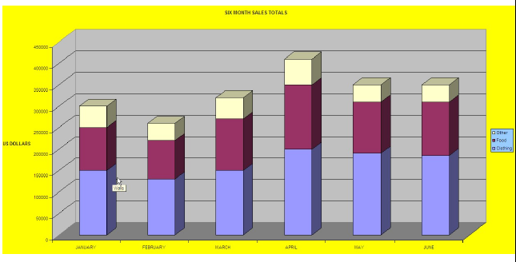
Terrible Graphs

Slide 11
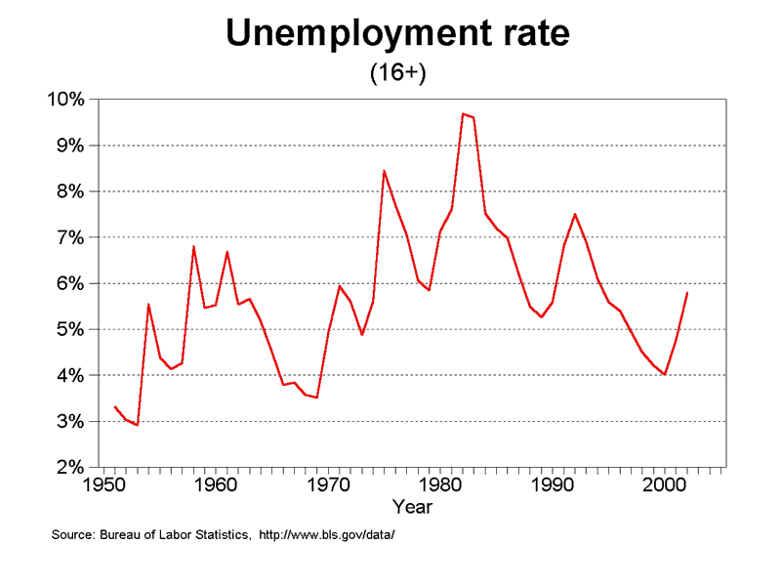
Less Terrible

Slide 12
Better Graph

Slide 13
Opening Files in Stata
When I open Stata, it tells me it’s using the directory:
afs/athena.mit.edu/a/d/adlynch
But, my files are located in:
afs/athena.mit.edu/a/d/adlynch/Graphing
I’m going to tell Stata where it should look for my files:
cd “~/Graphing”

Slide 14
Basic Graphing
Always know what you’re working with before you get started
Recognize scale of data
If you’re using multiple variables – how do their scales align?
Before any graphing procedure review variables with codebook, sum, tab, etc.
HELPFUL STATA HINT: If you want your command to go on multiple lines use “ ///” at end of each line

Slide 15
Basic Graphing: Single Continuous Variables
Example: Histograms
Stata assumes you’re working with continuous data
Very simple syntax:
hist varname
Put a comma after your varname and start adding options
bin(#) : change the number of bars that the graph displays
normal : overlay normal curve
addlabels : add actual values to bars

Slide 16
Our First Dataset
Time Magazine Public School Poll
Based on survey of 1,000 adults in U.S.
Conducted in August 2010
Questions regarding feelings about parental involvement, teachers union, current potential for reform

Slide 17
Basic Graphing: Single Continuous Variables
Example: Histograms
Change the numeric depiction of your data
Add these options after the comma
Choose one: density fraction frequency percent
hist varname, percent

Slide 18
Basic Graphing: Single Continuous Variables
Example: Histograms
Be sure to properly describe your histogram:
title(insert name of graph)
subtitle(insert subtitle of graph)
note(insert note to appear at bottom of graph)
caption(insert caption to appear below notes)

Slide 19
Basic Graphing: Single Continuous Variables
hist F1, bin(10) percent title(TITLE) subtitle(SUBTITLE) caption(CAPTION) note(NOTES)

Slide 20
Basic Graphing: Single Continuous Variables
Example: Histograms
Axis title options (default is variable label):
xtitle(insert x axis name)
ytitle(insert y axis name)
Don’t want axis titles?
xtitle(“”)
ytitle(“”)

Slide 21
Basic Graphing: Single Continuous Variables
Example: Histograms
Add labels to X or Y axis:
xlabel(insert x axis label)
ylabel(insert y axis label)
Tell Stata how to scale each axis
xlabel(start#(increment)end#)
xlabel(0(5)100)
This would label x-axis from 0-100 in increments of 5

Slide 22
Basic Graphing: Single Continuous Variables
hist F1, bin(10) percent title(TITLE) subtitle(SUBTITLE) caption(CAPTION) ///
note(NOTES) xtitle(Here's your x-axis title) ytitle(here's your y-axis title)

Slide 23
Basic Graphing: Single Categorical Variables
Example: Histograms
What if my variable is not continuous?
Simply specify “discrete” with options
Stata will produce one bar for each level (i.e. category) of variable
Use xlabel command to insert names of individual categories
…, xlabel(1 "White" 2 "Black" 3 "Asian" 4 "Hispanic" 5 "Other")

Slide 24
Basic Graphing: Single Categorical Variables
hist F4, title(Racial breakdown of Time Poll Sample) xtitle(Race) ///
ytitle(Percent) xlabel(1 "White" 2 "Black" 3 "Asian" 4 "Hispanic“ ///
5 "Other") discrete percent addlabels
*Note my use of the “ ///” to allow the command to continue on multiple lines

Slide 25
Comparing Responses Across Categorical Variables
tabplot rvb Q8

Slide 26
Comparing Responses Across Categorical Variables
tabplot rvb Q8, percent(Q8) title("Do you think public schools are" ///
"teaching students the skills they need?") subtitle ("") xtitle("") ytitle("") ///
xlabel(1 "Yes" 2 "No" 3"No Answer")

Slide 27
Exercise 1: Histograms and Tab Plots

Slide 28
The Twoway Family
Next Dataset:
National Neighborhood Crime Study (NNCS)
N=9,593 census tracts in 2000
Explore sources of variation in crime for communities in the United States
Tract-level data: crime, social disorganization, disadvantage, socioeconomic inequality
City-level data: labor market, socioeconomic inequality, population change

Slide 29
The Twoway Family
twoway is basic Stata command for all twoway graphs
Use twoway anytime you want to make comparisons among variables
Can be used to combine graphs (i.e., overlay one graph with another
e.g., insert line of best fit over a scatter plot

Slide 30
The Twoway Family
Most basic:
tw scatter T_PERCAP T_VIOLNT
tw dropline T_PERCAP T_VIOLNT
tw lfitci T_PERCAP T_VIOLNT

Slide 31
Twoways and the By Statement
twoway scatter T_PERCAP T_VIOLNT, by(DICEMP)

Slide 32
Twoway Title Options
Same title options as with histogram
title(insert name of graph)
subtitle(insert subtitle of graph)
note(insert note to appear at bottom of graph)
caption(insert caption to appear below notes)

Slide 33
Twoway Title Options
twoway scatter T_PERCAP T_VIOLNT, title(Comparison of Per Capita Income and Violent Crime Rate at Tract level) ///
xtitle(Violent Crime Rate) ytitle(Per Capita Income) note(Source: National Neighborhood Crime Study 2000)
Let’s fix that graph title – it is too cramped….

Slide 34
Twoway Title Options
twoway scatter T_PERCAP T_VIOLNT, title("Comparison of Per Capita Income" ///
"and Violent Crime Rate at Tract level") ///
xtitle(Violent Crime Rate) ytitle(Per Capita Income) ///
note(Source: National Neighborhood Crime Study 2000)
*Note how we got our title to go onto two lines

Slide 35
Twoway Symbol Options
- To call this chart up in Stata, type: palette symbolpalette
- Use msymbol() in graph options to change symbol

Slide 36
Twoway Symbol Options
twoway scatter T_PERCAP T_VIOLNT, title("Comparison of Per Capita Income" ///
"and Violent Crime Rate at Tract level") ///
xtitle(Violent Crime Rate) ytitle(Per Capita Income) ///
note(Source: National Neighborhood Crime Study 2000) ///
msymbol(Sh)
Here’s my msymbol() option

Slide 37
Twoway Symbol Options
Add “mcolor(insert color)” option to change color of symbol. Here, I just added “mcolor(red)” to the graph options.

Slide 38
Overlaying Twoway Graphs
Very simple to combine multiple graphs…just put each graph command in parentheses
twoway (scatter var1 var2) (lfit var1 var2)
Add individual options to each graph within the parentheses
Add overall graph options as usual following the comma
twoway (scatter var1 var2) (lfit var1 var2), options

Slide 39
Overlaying Twoway Graphs
twoway (scatter T_PERCAP T_VIOLNT) (lfit T_PERCAP T_VIOLNT), title("Comparison of ///
Per Capita Income" "and Violent Crime Rate at Tract level“) ///
xtitle(Violent Crime Rate) ytitle(Per Capita Income) note(Source: National ///
Neighborhood Crime Study 2000)

Slide 40
Overlaying Twoway Graphs
twoway (scatter T_PERCAP T_VIOLNT if T_VIOLNT==1976, mlabel(CITY)) (scatter T_PERCAP T_VIOLNT), ///
title("Comparison of Per Capita Income" "and Violent Crime Rate at Tract level") xlabel(0(200)2400) ///
note(Source: National Neighborhood Crime Study 2000) legend(off)

Slide 41
Exercise 2: The TwoWay Family

Slide 42
Line Graphs
Line graphs helpful for a variety of data
Especially any type of time series data
We’ll use data on US life expectancy from 1900-1999
webuse uslifeexp, clear
ok

Slide 43
Line Graphs
line le_wm le_bm year
*Simple line graph of men and women overtime

Slide 44
Line Graphs
line le_wfemale le_wmale le_wm le_bm year

Slide 45
Line Graphs: Adding Options
As usual…just keep adding options after the comma!
Same rules apply for titles that we’ve already seen for histograms and the twoway graphs
Let’s review how we can play with the appearance of our lines
Full listing of options type “help line_options”

Slide 46
Line Graphs: Changing Options
line le_wfemale le_wmale le_bf le_bm year, lpattern(dot solid dot solid)
“lpattern()” command allows me to change pattern from solid to dotted

Slide 47
Stata Graphing Lines
To call this up in Stata, type: palette linepalette

Slide 48
Line Graphs: Changing Options
line le_wfemale le_wmale le_bf le_bm year, lpattern(dot solid dot solid) ///
lcolor(red blue red blue) lwidth(thick thin thick thin)
Now I’ve used several different options to change line pattern, color and width

Slide 49
Profile Plots
Great way for comparing outcomes on continuous variables across different levels of categorical variables
Example: math, science and reading scores (continuous variables) across different curriculum programs
Profile plots is a Stata add-on (not in base package)
findit profileplot

Slide 50
Profile Plot
Let’s go back to the National Crime Survey and look at crime rates across different levels of unemployment at the tract level
First, create categorical variable separating unemployment rates into quartiles
*pay attention to what happens with missing data
Label new variable

Slide 51
Profile Plots
profileplot T_MURDRT T_AGASRT T_VIOLRT T_PROPRT, by(unempquart)

Slide 52
Profile Plots
profileplot T_MURDRT T_AGASRT T_VIOLRT T_PROPRT, by(unempquart) xlabel(1 "Murder" 2 "Assault" 3 "Violent" 4 "Property") ///
ytitle(Average Crime Rate) title("Average Tract Crime Rates by Unemployment Level") xtitle("")

Slide 53
Exporting Graphs
From Stata, right click on image and select “save as” or try syntax:
cd “~/Graphing”
graph export myfig.esp, replace
In Microsoft Word: insert > picture > from file
Or, right click on graph in Stata and copy and paste into Word

Slide 54
Other Services Available
MIT’s membership in HMDC provided by schools and departments at MIT
Institute for Quantitative Social Science
www.iq.harvard.edu
Research Computing
www.iq.harvard.edu/research_computing
Computer labs
www.iq.harvard.edu/facilities
Training
www.iq.harvard.edu/training
Data repository
http://libraries.mit.edu/get/hmdc

Slide 55
Thank you!
Thank you for participating in HMDC’s Introduction to Stata Workshop.
We offer additional statistical workshops in Stata, SAS and R throughout the semester:
Introduction to R: Monday December 6th: 1-4pm
*Note: This workshop is currently wait listed but will be offered again over IAP Introduction to SAS: Monday November 15th: 1-4pm
Sign up at:
http://libraries.mit.edu/guides/subjects/data/training/workshops.html

Slide 56
Thank you!
Can’t make it to the workshops at MIT? MIT users are also welcome to attend these same workshops at Harvard. Sign up anytime by emailing: dataclass@help.hmdc.harvard.edu
Graphics in Stata: Fri, Nov. 19th: 9 am to Noon Introduction to R: Fri, Dec. 3rd: 9 am to Noon Introduction to SAS: Fri, Nov. 5th: 9 am to Noon
http://support.hmdc.harvard.edu/kb-20/statistical_support

